Slide 1
UNIVERSITY OF PISA
Master of Science in Computer Engineering
DEPENDABLE AND SECURE SYSTEMS
ADVISE Car Attack
Teachers:
Prof.ssa Cinzia Bernardeschi
Ing. Maurizio Palmieri
Students:
Sebastiano Pala
Eleonora Sgorbini

Slide 2


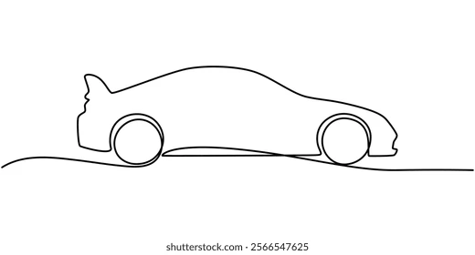

Requirements and Goals
Goals
Requirements
Create an ADVISE model on Mobius for adversaries trying to attack the communication channels of a car
Analyze and interpret the results
Evaluate the probability of each adversary to achieve the goal of stealing private data
It is required to build an attack graph with roughly 20 elements
At least 2 different adversary profiles are required
The elements of the AEG must be explicitly linked with the table
Notes:
ele

Slide 3

Attack Execution Graph
POSSIBLE PATHS
AS1 $→$ AS2 $→$ AS6
AS4 $→$ AS7
AS5 $→$ AS7
AS4 $→$ AS3 $→$ AS2 $→$ AS6
AS5 $→$ AS3 $→$ AS2 $→$ AS6
Notes:
ele

Slide 4
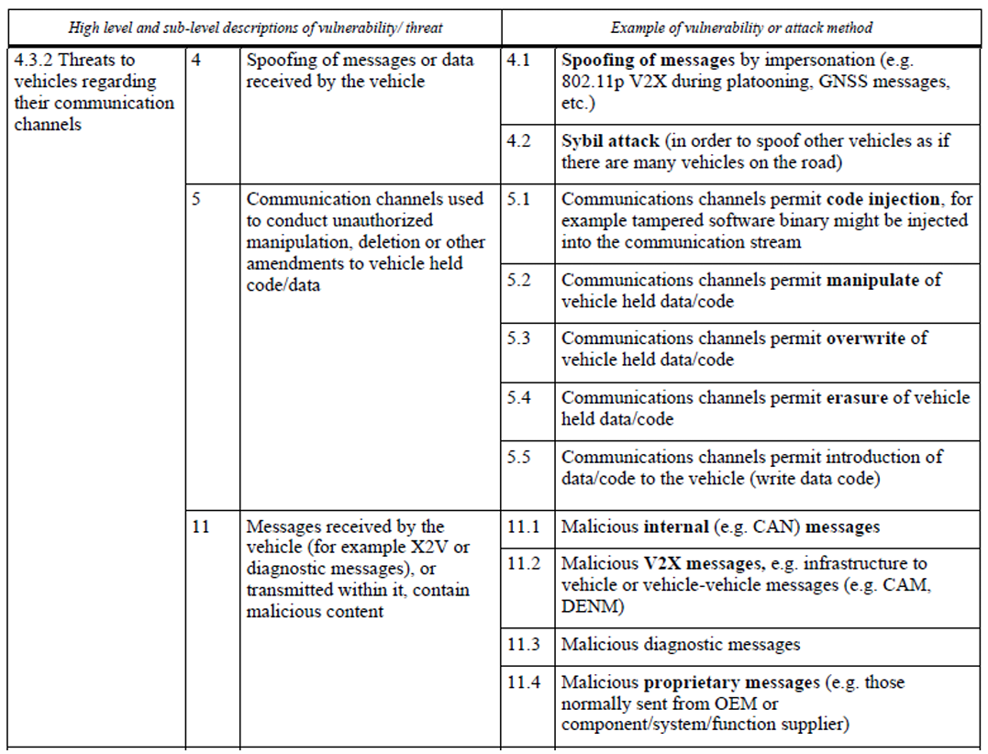
Attack Steps
AS5: Inject Tampered Binary
AS6: Extract Data via CAN Bus
AS7: Extract Data Remotely
AS3: Reflash Gateway Chip
AS2: Inject Malicious CAN Messages
AS1: Send V2X Malicious Messages
AS4: Impersonate OEM
Notes:
ele

Slide 5
Experiment Setup
EVALUATION SCALES
Cost Scale
Skill Scale
Range | Interpretation
0-20 | Very cheap, affordable
21-50 | Requires a small investment
51-80 | Requires a serious budget
81-100 | Very expensive
Range | Level | Interpretation
0-200 | Novice | No specific skills
201-500 | Intermediate | Security researcher
501-800 | Advanced | Professional penetration tester
801-1000 | Expert | World expert
Time Scale
Payoff Choice
The payoff of the unique goal (G1) was set to 1000 (the maximum value allowed by Mobius)
Range | Interpretation
0-2 | Requires one hour
3-5 | Requires around two hours
6-8 | Requires three to four hours
9-10 | Requires up to five hours
Notes:
seba

Slide 6
Experiment Setup
Attack Step | Required Skill | Threshold
AS1 – Send V2X Malicious Messages | S1 – V2XPacketCraftingSkill | 300
AS2 – Inject Malicious CAN Messages | S2 – SpoofingSkill | 350
AS3 – Reflash Gateway Chip | S4 – ChipFlashingSkill | 700
AS4 – Impersonate OEM | S2 - SpoofingSkill | 450
AS5 – Inject Tampered Binary | S3 – InjectionSkill | 500
AS6 – Extract Data via CAN Bus | S5 – DataExtractionSkill | 250
AS7 – Extract Data Remotely | S5 – DataExtractionSkill | 300
Notes:
seba

Slide 7
Experiment Setup
EXECUTION PARAMETERS AND PROBABILITIES
Attack Step | Cost | Time | Outcome Prob. |  | Detection Prob.
 |  |  | Success | Failure | Success | Failure
AS1 – Send V2X Malicious Messages | 10 | 3 | 0.40 | 0.60 | 0.35 | 0.45
AS2 – Inject Malicious CAN Messages | 10 | 2 | 0.75 | 0.25 | 0.15 | 0.20
AS3 – Reflash Gateway Chip | 35 | 9 | 0.70 | 0.30 | 0.30 | 0.30
AS3 – Reflash Gateway Chip - EXP | 15 | 5 | 0.90 | 0.10 | 0.10 | 0.25
AS4 – Impersonate OEM | 30 | 5 | 0.70 | 0.30 | 0.10 | 0.10
AS5 – Inject Tampered Binary | 20 | 7 | 0.75 | 0.25 | 0.30 | 0.30
AS6 – Extract Data via CAN Bus | 5 | 2 | 0.90 | 0.10 | 0.10 | 0.30
AS7 – Extract Data Remotely | 15 | 3 | 0.50 | 0.50 | 0.30 | 0.60
Notes:
seba

Slide 8
Experiment Setup
GLOBAL VARIABLES
ADVERSARY PROFILES
Type | Global Variable | Value
bool | A1 – hasProximityAccess | [0, 1]
bool | A3 – hasRemoteNetworkAccess | [0, 1]
bool | K1 – hasV2XProtocolKnowledge | [0, 1]
bool | K2 – hasCarModelKnowledge | [0, 1]
bool | K3 – hasMessageFormatKnowledge | [0, 1]
short | S1 – v2XPacketCraftingSkillLevel | [0, 1000]
short | S2 – spoofingSkillLevel | [0, 400, 1000]
short | S3 – injectionSkillLevel | [0, 1000]
short | S4 – chipFlashingSkillLevel | [0, 750, 1000]
short | S5 – dataExtractionSkillLevel | [0, 275, 1000]
Remote Adversary
Proximity Adversary
Hybrid Adversary
ADVERSARY WEIGHTS
Mindset | Cost Weight | Detection Weight | Payoff Weight
Economic | 0.4 | 0.1 | 0.5
Stealthy | 0.1 | 0.3 | 0.6
Stubborn | 0.1 | 0.1 | 0.8
The total number of experiments for each configuration is 3456. Only 7 of them were analyzed
Notes:
ele

Slide 9
Experiment Setup
Type I
Remote Adversary Only (Exp 3419, 3420)
Type II
Lack of extraction skill (Exp 3452, 3453)
Notes:
ele

Slide 10
Experiment Setup
Type III
Lack of chip flashing skill (Exp 3454)
Type IV
All paths available (Exp 3455, 3456)
Notes:
ele

Slide 11
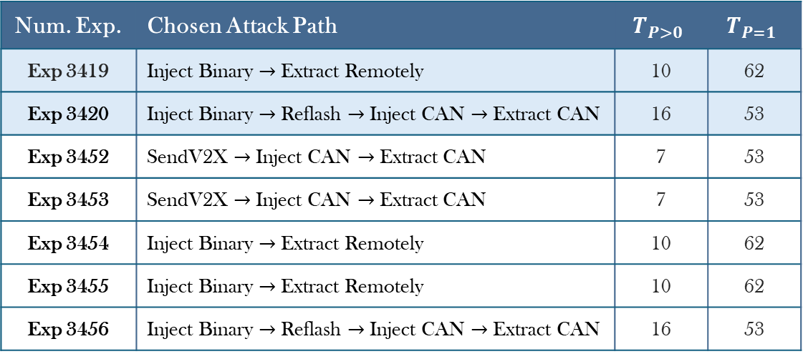
Simulation Results
Payoff-Based Adversary
Cost: 0.1 | Detection: 0.1 | Payoff: 0.8
Num. Exp. | Chosen Attack Path | $$T_{P>0}$$ | $$T_{P=1}$$
Exp 3419 | Inject Binary $→$ Extract Remotely | 10 | 62
Exp 3420 | Inject Binary $→$ Reflash $→$ Inject CAN $→$ Extract CAN | 16 | 53
Exp 3452 | SendV2X $→$ Inject CAN $→$ Extract CAN | 7 | 53
Exp 3453 | SendV2X $→$ Inject CAN $→$ Extract CAN | 7 | 53
Exp 3454 | Inject Binary $→$ Extract Remotely | 10 | 62
Exp 3455 | Inject Binary $→$ Extract Remotely | 10 | 62
Exp 3456 | Inject Binary $→$ Reflash $→$ Inject CAN $→$ Extract CAN | 16 | 53
Notes:
seba

Slide 12
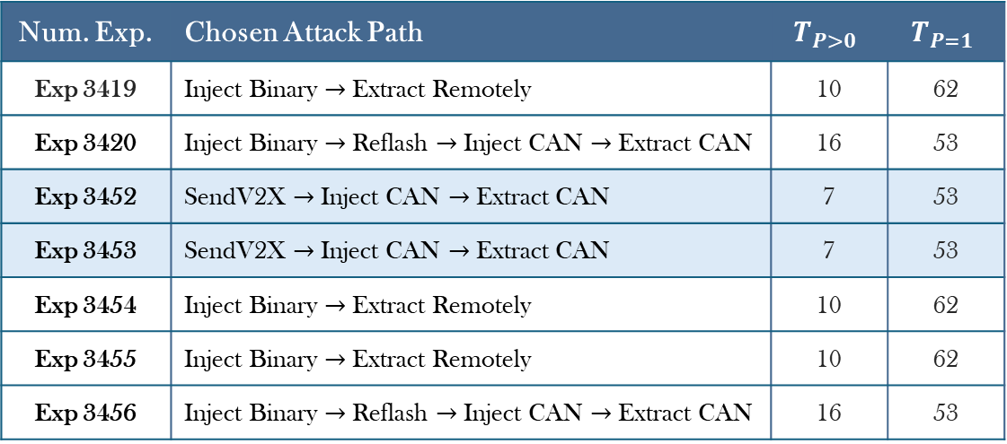
Simulation Results
Payoff-Based Adversary
Cost: 0.1 | Detection: 0.1 | Payoff: 0.8
Num. Exp. | Chosen Attack Path | $$T_{P>0}$$ | $$T_{P=1}$$
Exp 3419 | Inject Binary $→$ Extract Remotely | 10 | 62
Exp 3420 | Inject Binary $→$ Reflash $→$ Inject CAN $→$ Extract CAN | 16 | 53
Exp 3452 | SendV2X $→$ Inject CAN $→$ Extract CAN | 7 | 53
Exp 3453 | SendV2X $→$ Inject CAN $→$ Extract CAN | 7 | 53
Exp 3454 | Inject Binary $→$ Extract Remotely | 10 | 62
Exp 3455 | Inject Binary $→$ Extract Remotely | 10 | 62
Exp 3456 | Inject Binary $→$ Reflash $→$ Inject CAN $→$ Extract CAN | 16 | 53
Notes:
seba

Slide 13
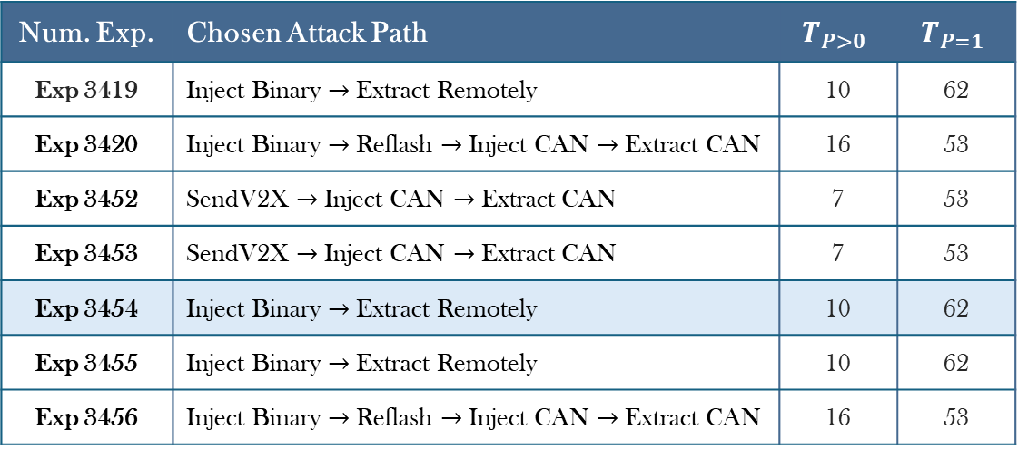
Simulation Results
Payoff-Based Adversary
Cost: 0.1 | Detection: 0.1 | Payoff: 0.8
Num. Exp. | Chosen Attack Path | $$T_{P>0}$$ | $$T_{P=1}$$
Exp 3419 | Inject Binary $→$ Extract Remotely | 10 | 62
Exp 3420 | Inject Binary $→$ Reflash $→$ Inject CAN $→$ Extract CAN | 16 | 53
Exp 3452 | SendV2X $→$ Inject CAN $→$ Extract CAN | 7 | 53
Exp 3453 | SendV2X $→$ Inject CAN $→$ Extract CAN | 7 | 53
Exp 3454 | Inject Binary $→$ Extract Remotely | 10 | 62
Exp 3455 | Inject Binary $→$ Extract Remotely | 10 | 62
Exp 3456 | Inject Binary $→$ Reflash $→$ Inject CAN $→$ Extract CAN | 16 | 53
Notes:
seba

Slide 14
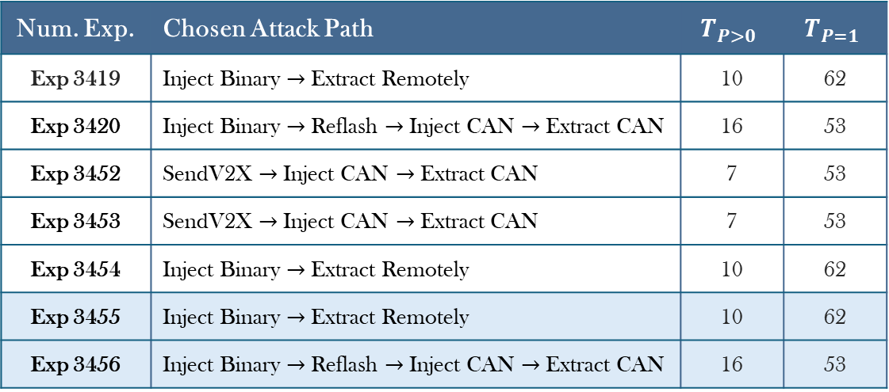
Simulation Results
Payoff-Based Adversary
Cost: 0.1 | Detection: 0.1 | Payoff: 0.8
Num. Exp. | Chosen Attack Path | $$T_{P>0}$$ | $$T_{P=1}$$
Exp 3419 | Inject Binary $→$ Extract Remotely | 10 | 62
Exp 3420 | Inject Binary $→$ Reflash $→$ Inject CAN $→$ Extract CAN | 16 | 53
Exp 3452 | SendV2X $→$ Inject CAN $→$ Extract CAN | 7 | 53
Exp 3453 | SendV2X $→$ Inject CAN $→$ Extract CAN | 7 | 53
Exp 3454 | Inject Binary $→$ Extract Remotely | 10 | 62
Exp 3455 | Inject Binary $→$ Extract Remotely | 10 | 62
Exp 3456 | Inject Binary $→$ Reflash $→$ Inject CAN $→$ Extract CAN | 16 | 53
Notes:
seba

Slide 15
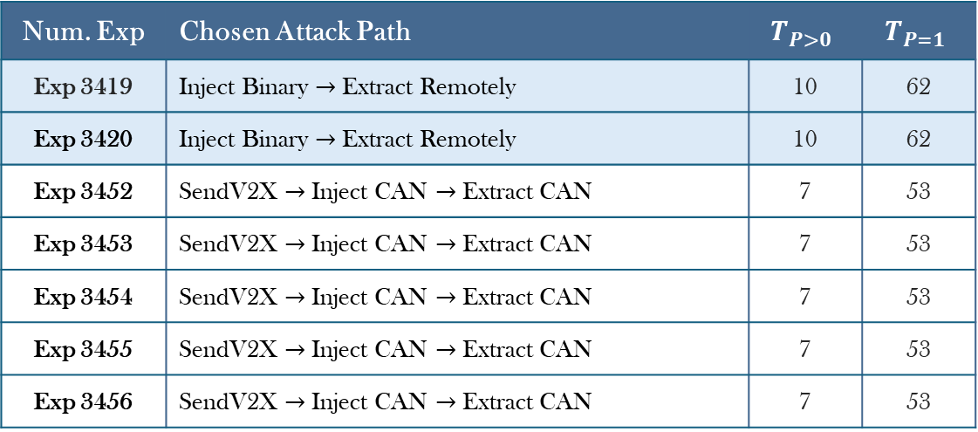
Simulation Results
Cost-Based Adversary
Cost: 0.4 | Detection: 0.1 | Payoff: 0.5
Num. Exp | Chosen Attack Path | $$T_{P>0}$$ | $$T_{P=1}$$
Exp 3419 | Inject Binary $→$ Extract Remotely | 10 | 62
Exp 3420 | Inject Binary $→$ Extract Remotely | 10 | 62
Exp 3452 | SendV2X $→$ Inject CAN $→$ Extract CAN | 7 | 53
Exp 3453 | SendV2X $→$ Inject CAN $→$ Extract CAN | 7 | 53
Exp 3454 | SendV2X $→$ Inject CAN $→$ Extract CAN | 7 | 53
Exp 3455 | SendV2X $→$ Inject CAN $→$ Extract CAN | 7 | 53
Exp 3456 | SendV2X $→$ Inject CAN $→$ Extract CAN | 7 | 53
Notes:
ele

Slide 16
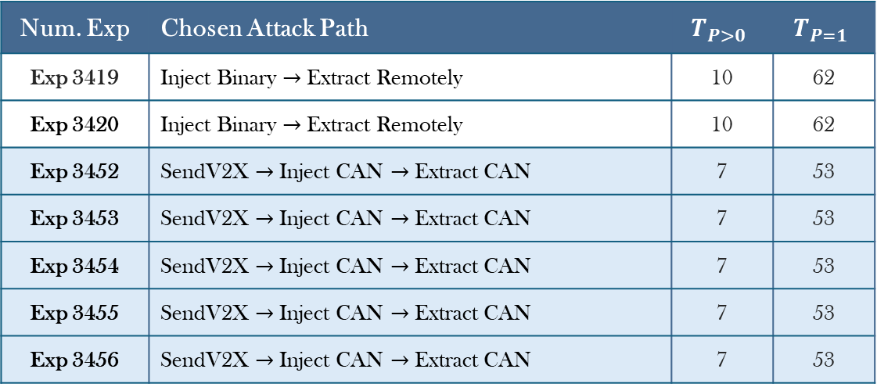
Simulation Results
Cost-Based Adversary
Cost: 0.4 | Detection: 0.1 | Payoff: 0.5
Num. Exp | Chosen Attack Path | $$T_{P>0}$$ | $$T_{P=1}$$
Exp 3419 | Inject Binary $→$ Extract Remotely | 10 | 62
Exp 3420 | Inject Binary $→$ Extract Remotely | 10 | 62
Exp 3452 | SendV2X $→$ Inject CAN $→$ Extract CAN | 7 | 53
Exp 3453 | SendV2X $→$ Inject CAN $→$ Extract CAN | 7 | 53
Exp 3454 | SendV2X $→$ Inject CAN $→$ Extract CAN | 7 | 53
Exp 3455 | SendV2X $→$ Inject CAN $→$ Extract CAN | 7 | 53
Exp 3456 | SendV2X $→$ Inject CAN $→$ Extract CAN | 7 | 53
Notes:
ele

Slide 17
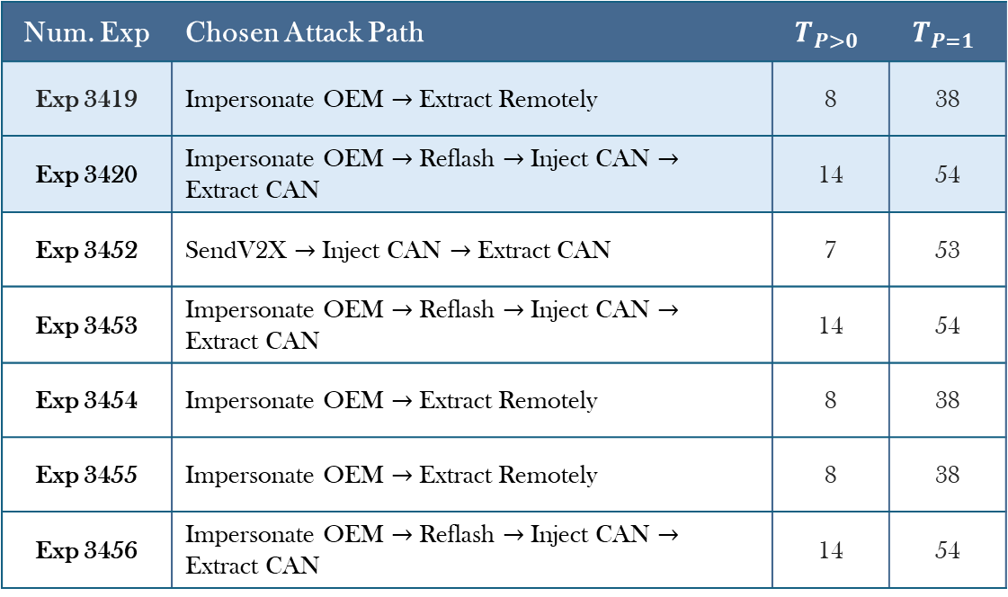
Simulation Results
Detection-Based Adversary
Cost: 0.1 | Detection: 0.3 | Payoff: 0.6
Num. Exp | Chosen Attack Path | $$T_{P>0}$$ | $$T_{P=1}$$
Exp 3419 | Impersonate OEM $→$ Extract Remotely | 8 | 38
Exp 3420 | Impersonate OEM $→$ Reflash $→$ Inject CAN $→$ Extract CAN | 14 | 54
Exp 3452 | SendV2X $→$ Inject CAN $→$ Extract CAN | 7 | 53
Exp 3453 | Impersonate OEM $→$ Reflash $→$ Inject CAN $→$ Extract CAN | 14 | 54
Exp 3454 | Impersonate OEM $→$ Extract Remotely | 8 | 38
Exp 3455 | Impersonate OEM $→$ Extract Remotely | 8 | 38
Exp 3456 | Impersonate OEM $→$ Reflash $→$ Inject CAN $→$ Extract CAN | 14 | 54
Notes:
ele

Slide 18
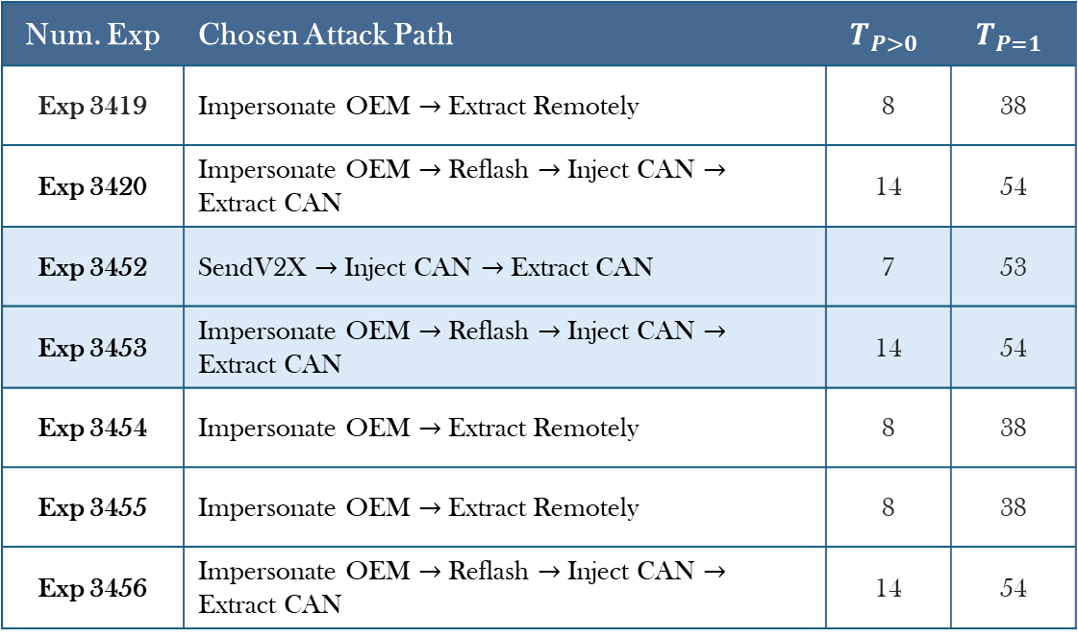
Simulation Results
Detection-Based Adversary
Cost: 0.1 | Detection: 0.3 | Payoff: 0.6
Num. Exp | Chosen Attack Path | $$T_{P>0}$$ | $$T_{P=1}$$
Exp 3419 | Impersonate OEM $→$ Extract Remotely | 8 | 38
Exp 3420 | Impersonate OEM $→$ Reflash $→$ Inject CAN $→$ Extract CAN | 14 | 54
Exp 3452 | SendV2X $→$ Inject CAN $→$ Extract CAN | 7 | 53
Exp 3453 | Impersonate OEM $→$ Reflash $→$ Inject CAN $→$ Extract CAN | 14 | 54
Exp 3454 | Impersonate OEM $→$ Extract Remotely | 8 | 38
Exp 3455 | Impersonate OEM $→$ Extract Remotely | 8 | 38
Exp 3456 | Impersonate OEM $→$ Reflash $→$ Inject CAN $→$ Extract CAN | 14 | 54
Notes:
ele

Slide 19
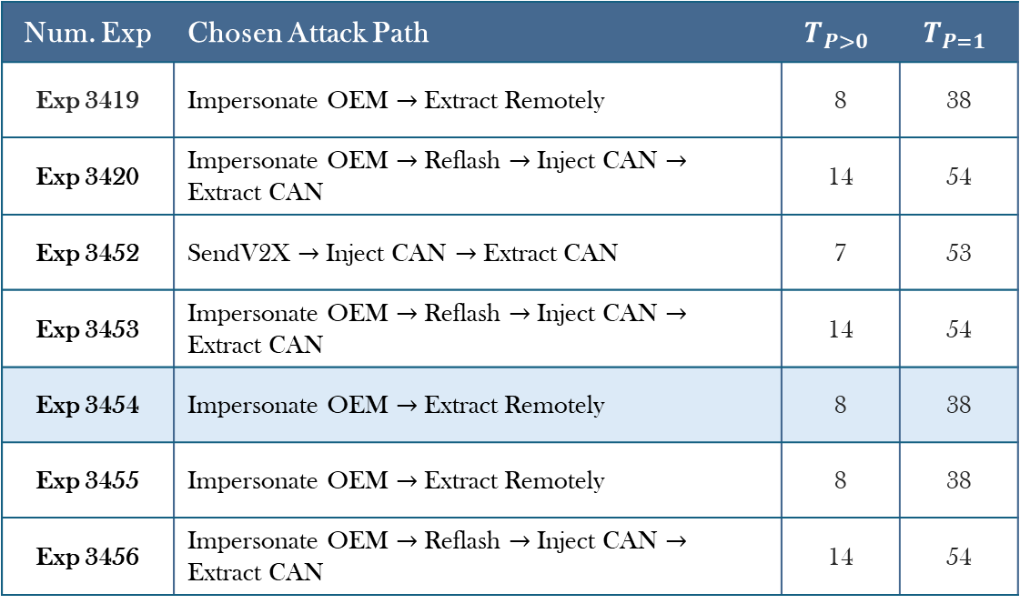
Simulation Results
Detection-Based Adversary
Cost: 0.1 | Detection: 0.3 | Payoff: 0.6
Num. Exp | Chosen Attack Path | $$T_{P>0}$$ | $$T_{P=1}$$
Exp 3419 | Impersonate OEM $→$ Extract Remotely | 8 | 38
Exp 3420 | Impersonate OEM $→$ Reflash $→$ Inject CAN $→$ Extract CAN | 14 | 54
Exp 3452 | SendV2X $→$ Inject CAN $→$ Extract CAN | 7 | 53
Exp 3453 | Impersonate OEM $→$ Reflash $→$ Inject CAN $→$ Extract CAN | 14 | 54
Exp 3454 | Impersonate OEM $→$ Extract Remotely | 8 | 38
Exp 3455 | Impersonate OEM $→$ Extract Remotely | 8 | 38
Exp 3456 | Impersonate OEM $→$ Reflash $→$ Inject CAN $→$ Extract CAN | 14 | 54
Notes:
ele

Slide 20
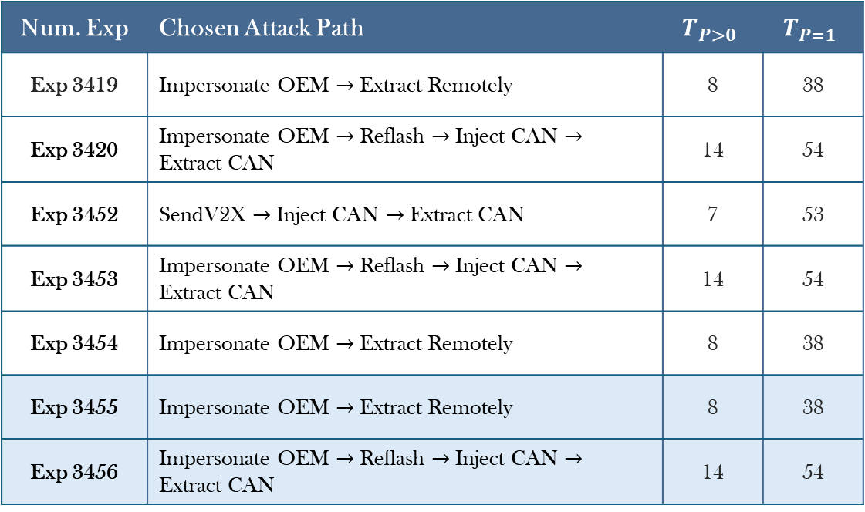
Simulation Results
Detection-Based Adversary
Cost: 0.1 | Detection: 0.3 | Payoff: 0.6
Num. Exp | Chosen Attack Path | $$T_{P>0}$$ | $$T_{P=1}$$
Exp 3419 | Impersonate OEM $→$ Extract Remotely | 8 | 38
Exp 3420 | Impersonate OEM $→$ Reflash $→$ Inject CAN $→$ Extract CAN | 14 | 54
Exp 3452 | SendV2X $→$ Inject CAN $→$ Extract CAN | 7 | 53
Exp 3453 | Impersonate OEM $→$ Reflash $→$ Inject CAN $→$ Extract CAN | 14 | 54
Exp 3454 | Impersonate OEM $→$ Extract Remotely | 8 | 38
Exp 3455 | Impersonate OEM $→$ Extract Remotely | 8 | 38
Exp 3456 | Impersonate OEM $→$ Reflash $→$ Inject CAN $→$ Extract CAN | 14 | 54
Notes:
ele

Slide 21
Conclusions
Exploitation Drivers
Real-world attacks do not follow a fixed path, as they are dictated by adversary constraints (budget, time) and strategic goals (reward, stealth)
Perimeter Security
Manufacturers must secure accessible external interfaces like V2X and remote endpoints, limiting the adversary's attack surface
Attack Discouragement
Using better components and protocols can increase the cost and difficulty of most attacks, reducing the adversary's success probability
Internal Defense
Robust internal monitoring can help neutralize skilled attackers who bypass the initial perimeter
Notes:
seba

Slide 22
THANK YOU
FOR YOUR ATTENTION

